Slide 1




TNA user feedback
Advanced microscopy characterization of
innovative ceramic coatings for hydrogen technologies
Elisa Zanchi
Politecnico di Torino, Italy
THIS PROJECT HAS RECEIVED FUNDING FROM THE EUROPEAN UNION’S HORIZON 2020 RESEARCH AND INNOVATION PROGRAMME UNDER GRANT AGREEMENT NO 823717

Slide 2
Outline
Network and collaborations around ESTEEM3 project
The CeramECS project: “Glass-ceramic and ceramic materials for energy conversion and storage”
Motivation: Solid Oxide Cell technologies for hydrogen energy
  Ceramic protective coatings
  Electrophoretic deposition (EPD)
  Advanced TEM characterization
Further activities: the GlaMater project
Concluding remarks
Elisa Zanchi, Politecnico di Torino

Slide 3









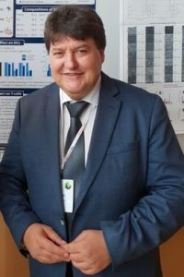







Network and collaborations
EPD processing
Advanced microscopy characterization
F. Smeacetto, E. Zanchi
G. Cempura
Department of Applied science and Technology,
Institute of Physics, GLANCE Group, Turin, Italy
International Centre of Electron Microscopy for
Materials Science at the AGH-UST, Krakow, Poland
EPD upscaling
Barcelona,
Spain
A.G. Sabato
Industrial partner
for EU projects
Stack testing
Electrophoretic deposition expertise
Testing & characterisation
Erlangen, Germany
Dresden, Germany
Gdansk, Poland
S. Molin,
J. Ignaczak
A.R. Boccaccini
H. Javed
GA # 700300
GA # 874577
Elisa Zanchi, Politecnico di Torino

Slide 4
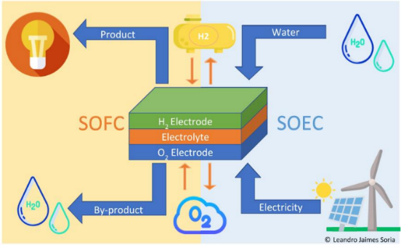
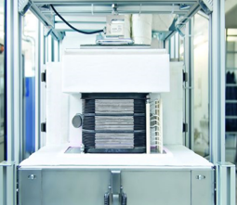
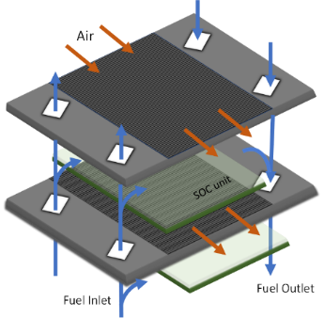

Motivation: H₂ technologies
Solid oxide cells (SOCs) are electrochemical energy conversion
devices operating at temperatures in the range of 600–850 °C
SOEC: Electrical energy ➔ Chemical energy (H₂)
SOFC: Chemical energy (H₂)➔ Electrical energy
rSOC: integration in renewable energy systems
Interconnect
Why SOCs?
Efficient energy conversion technology
Clean: Low GHGs emissions
Reduction of CO₂ fingerprint
30 cells stack,
Sunfire GmbH
Elisa Zanchi, Politecnico di Torino

Slide 5
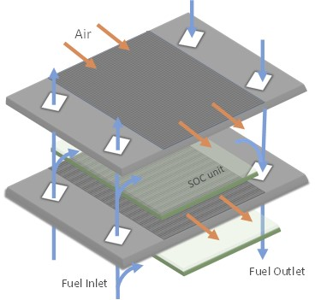
SOC stack
Ferritic stainless-steels are widely used as interconnects SOC stacks
  Electrical connection
  Separation between oxidizing/reducing atmosphere
HT corrosion
  Progressive oxidation limits the electric conductivity
  Volatile Cr-compounds degrade the cell performance
  I) Deposition of a ceramic protective coating
Gas tightness
  Need to completely avoid gas leakage
  Suppress undesired reactions
  II) Design of innovative interface concepts
Interconnect
CeramECS
Grant # 874577 - NewSOC
Elisa Zanchi, Politecnico di Torino

Slide 6
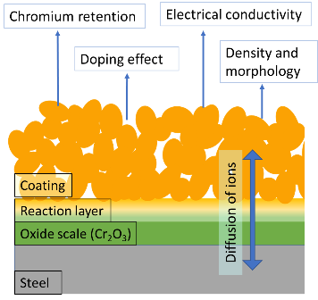
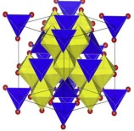
HT corrosion
Applying a protective coating on the steel is a promising approach to extend the interconnect life and avoid cathode poisoning
The coating must:
Reduce the oxidation rate of the steel
Reduce Cr-evaporation
Ensure high electrical conductivity
Compatible thermal expansion coefficient
(11-13 10⁻⁶ K⁻¹)
E. Zanchi et al., J. Power Sources. 455 (2020) 227910.
Co
The Mn-Co spinel family (MCO) has been shown to be particularly promising
The functional properties can be improved by
Modifications with additional elements – doping
Optimized deposition and sintering
Mn
Xu et al, Science 21 (2019) 19
Elisa Zanchi, Politecnico di Torino

Slide 7
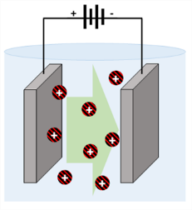
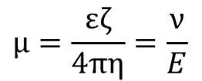
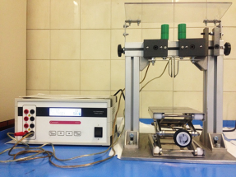

Electrophoretic deposition
Electrophoresis : motion of charged particles in a suspension
under the influence of an electric field
Deposition: coagulation of particles to a dense mass
E. Zanchi, et al., Mater. Lett. 286 (2021) 129229
Hamaker’s equation:
$$m= C_{s}µSEt$$
Experimental challenges:
Stability of the suspension
Deposition parameters
Sintering process
m= mass deposited at time t on surface S
Cs = concentration in the suspension
µ = electrophoretic mobility
E = electric field applied
ε = dielectric constant of the liquid.
η = viscosity of the liquid.
ζ = Zeta potential.
v = particle velocity.
Compared to other techniques, EPD
Has a simple and adaptable set-up
Is a fast and versatile technique
Reduces processing time and cost
1) Upscale of the electrophoretic deposition set-up
2) Modification of the spinel by electrophoretic co-deposition
EPD set-up @ POLITO
Elisa Zanchi, Politecnico di Torino

Slide 8
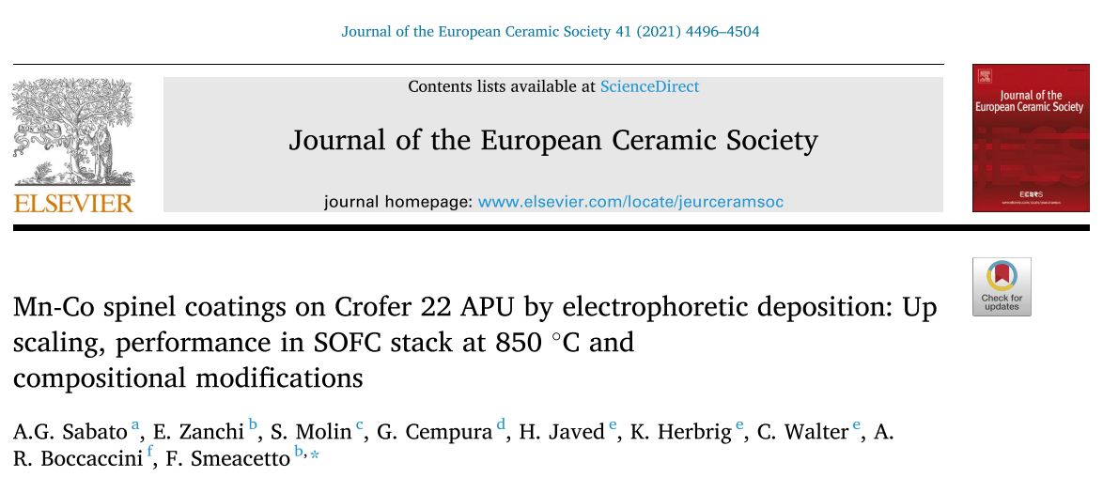
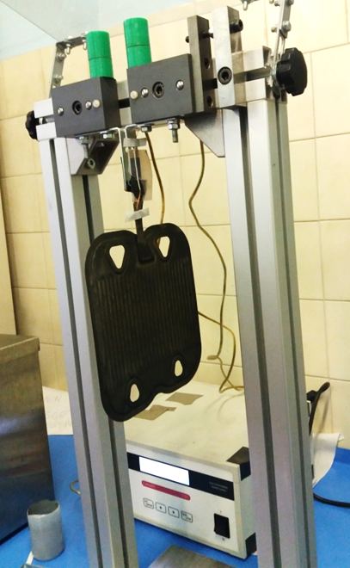

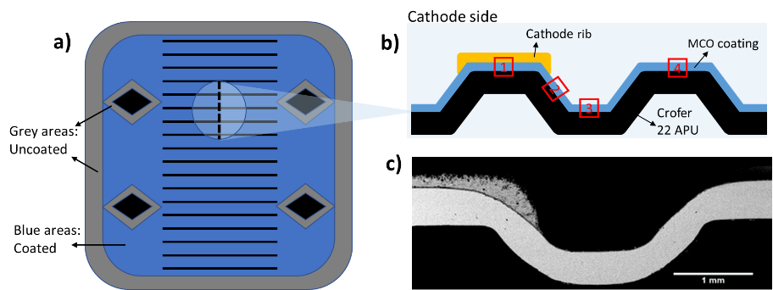
CeramECS
Glass-ceramic and ceramic materials for energy conversion and storage
EPD apparatus upscale
…to validate EPD for real dimension devices
EPD adapted to a 3-electrode set-up
̴20x20 cm surface successfully deposited
GA # 700300
SOC Stack test: 850 °C, 3000 h
The EPD deposited
Mn–Co spinel coating showed improved stability
Elisa Zanchi, Politecnico di Torino

Slide 9
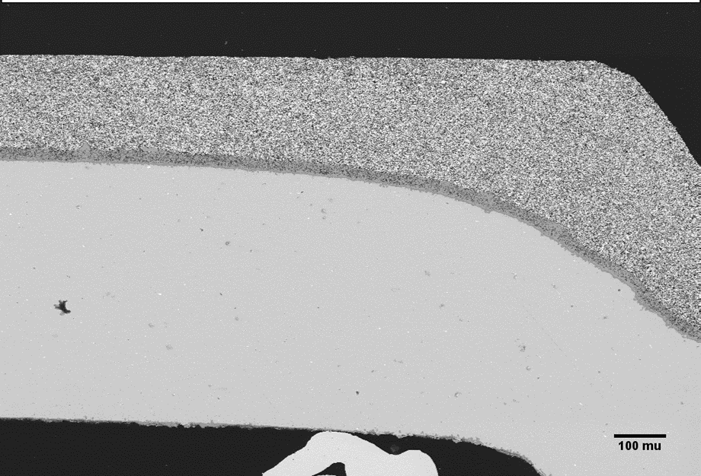
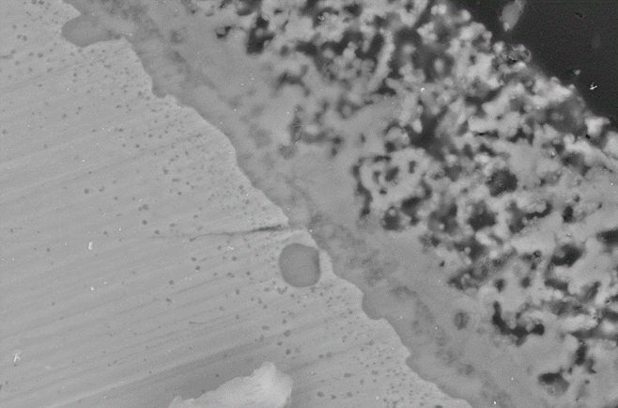
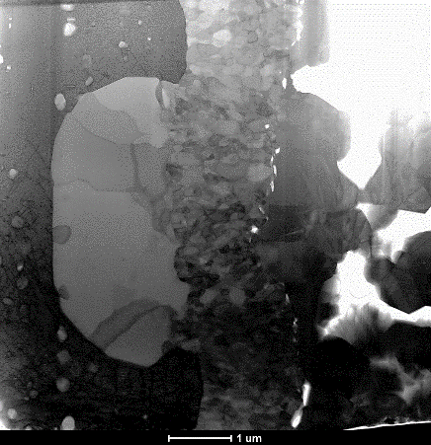
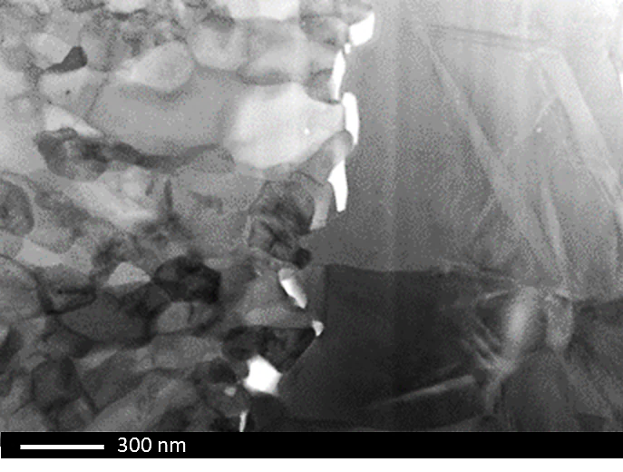
Mn-Co spinel coating
Advanced TEM post-mortem characterization
MCO EPD coating
Fib lamella:
to investigate reactions at the steel-coating interface and developed phases
Crofer22APU
Crofer22APU
Oxide Scale
Crofer22APU
Coating
Oxide scale
MCO coating
Overview
of the
FIB lamella
Magnification of oxide scale-coating
interface
Elisa Zanchi, Politecnico di Torino

Slide 10
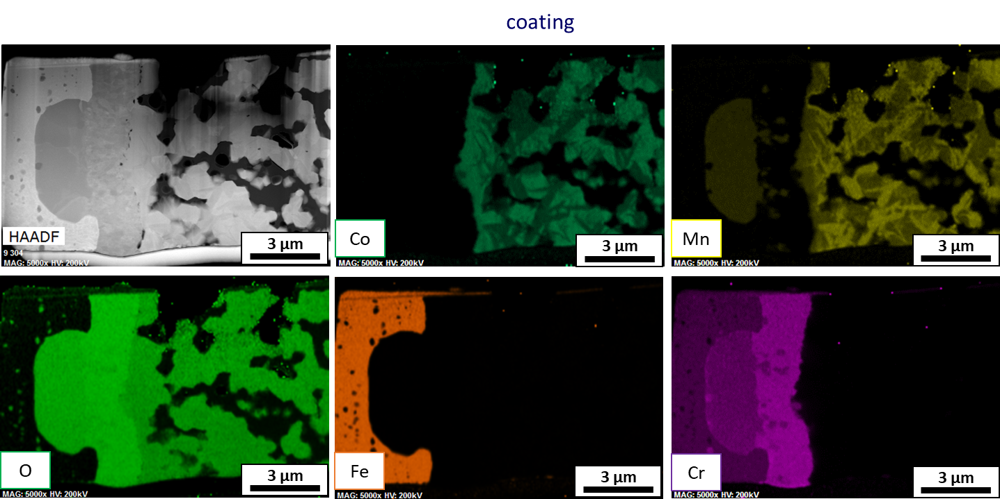
Mn-Co spinel coating
Overview of the FIB lamella from coated interconnect
Scale
Coating
Crofer22APU
EDS map of the lamella:
Different Mn and Co distribution in the coating
Cr confined in the oxide scale and absence of “reaction layer”
Mn-rich sub scale oxidation
Elisa Zanchi, Politecnico di Torino

Slide 11
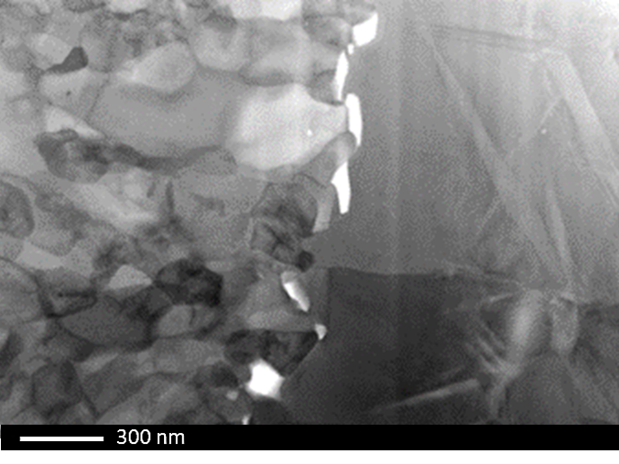
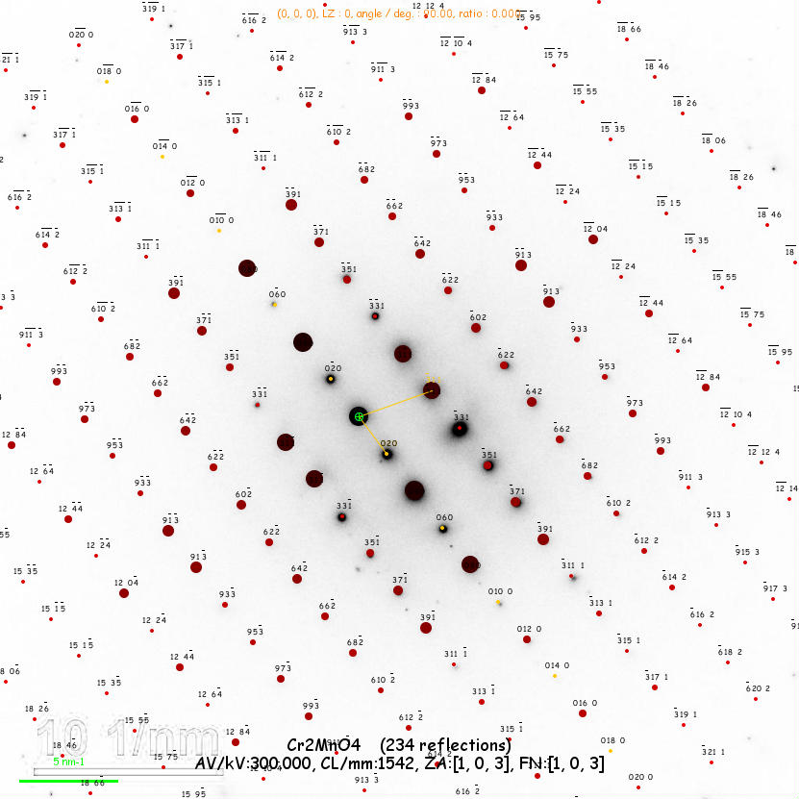
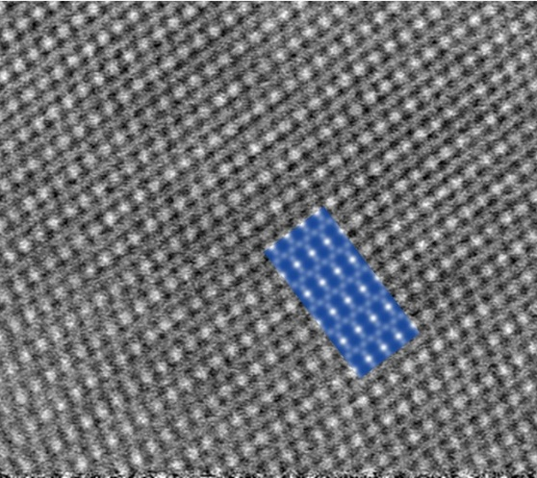
Mn-Co spinel coating
Advanced TEM characterisation of oxide scale–coating interface
Oxide scale
Coating
Simulated SAED of Cr₂MnO₄, superimposed on experimental one
EDS composition
O | Cr | Mn | Fe
59.2 | 30.4 | 10.0 | 0.2
Mn-rich oxide scale grain
Experimental HAADF –STEM and Simulated HAADF STEM
Remarkable diffusion of Mn leading to Cr-Mn spinel formation
Increased the electric conductivity and lower Cr evaporation compared to pure chromia scale
Elisa Zanchi, Politecnico di Torino

Slide 12
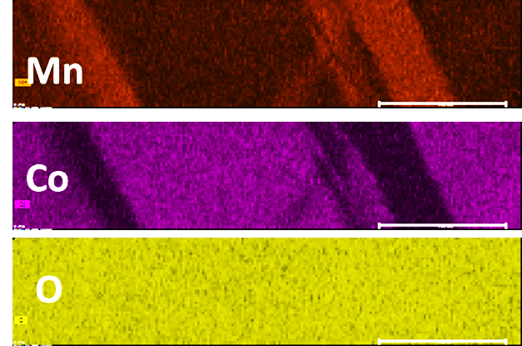
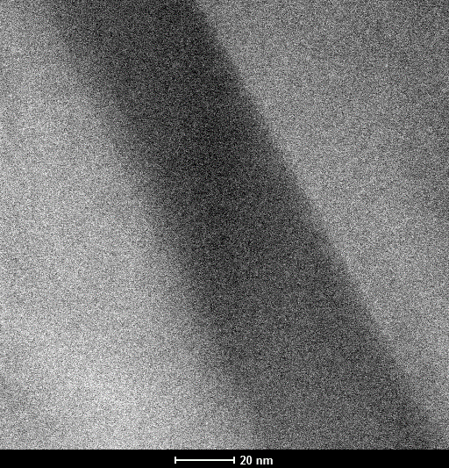
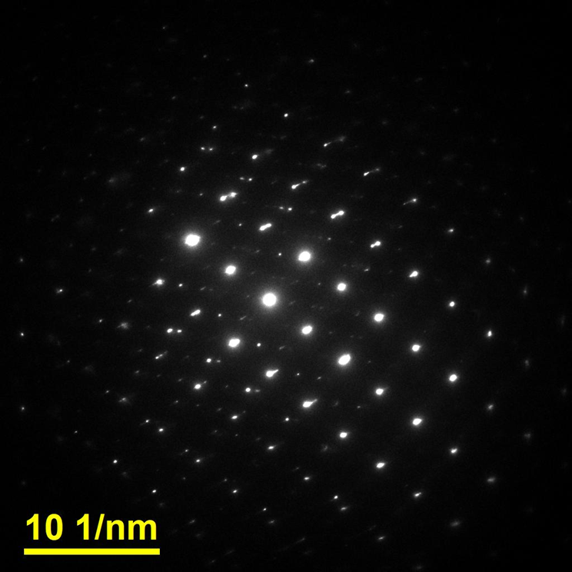
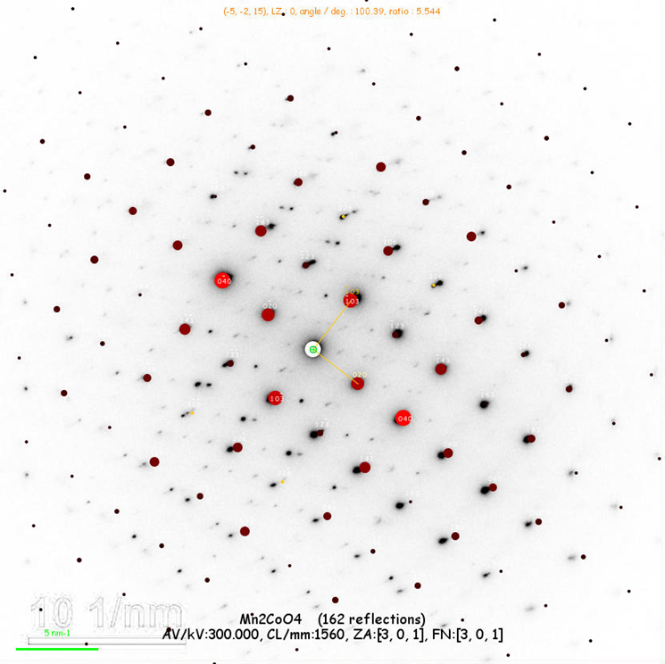
Mn-Co spinel coating
Advanced TEM characterisation of oxide scale–coating interface
Oxide scale
Coating
1
2
At.% | O | Cr | Mn | Co | Fe
1 | 53.5 | 0.6 | 17.6 | 27.8 | 0.6
2 | 54.5 | 1.3 | 29.1 | 14.8 | 0.3
Dual phase structure of the
Mn-Co spinel coating
Cobalt-rich grains: MnCo₂O₄ cubic structure
Mn-rich elongated grains: Mn₂CoO₄ tetragonal structure
Simulated SAED of Mn₂CoO₄ superimposed on exp.
one [ZA 301]
Elisa Zanchi, Politecnico di Torino

Slide 13
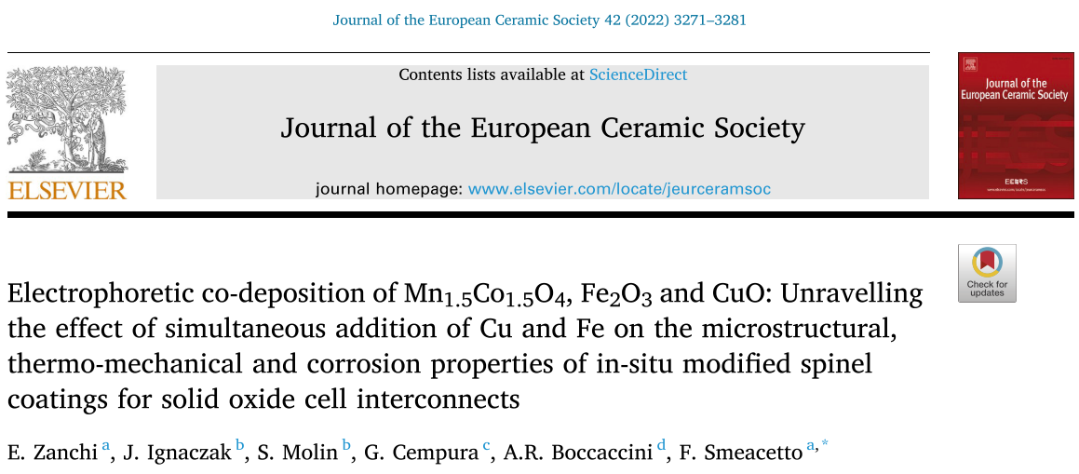
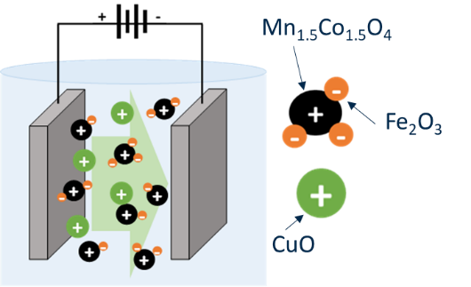
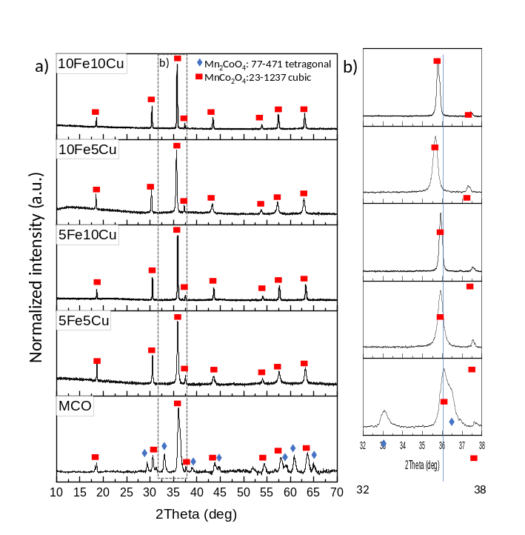
CeramECS
Glass-ceramic and ceramic materials for energy conversion and storage
Fe-Cu co-doping of the Mn-Co spinel coating
…to improve the functional properties of the Mn-Co spinel by addition of transition metals
Electrophoretic co-deposition of 3 precursors:
cathodic deposition
Two-step
Reactive sintering:
Reduction
Re-oxidation
Successful in-situ doping: Stabilization of the cubic spinel structure
Water-ethanol suspension
Deposited on Crofer22APU
Optimised deposition at 50 V for 30 s
Four different spinel compositions
Elisa Zanchi, Politecnico di Torino

Slide 14
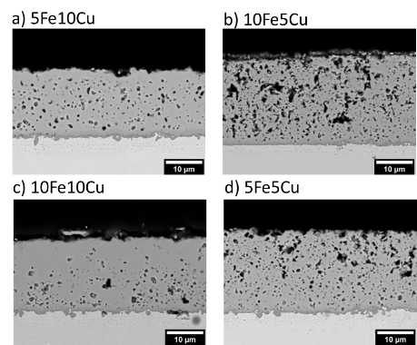
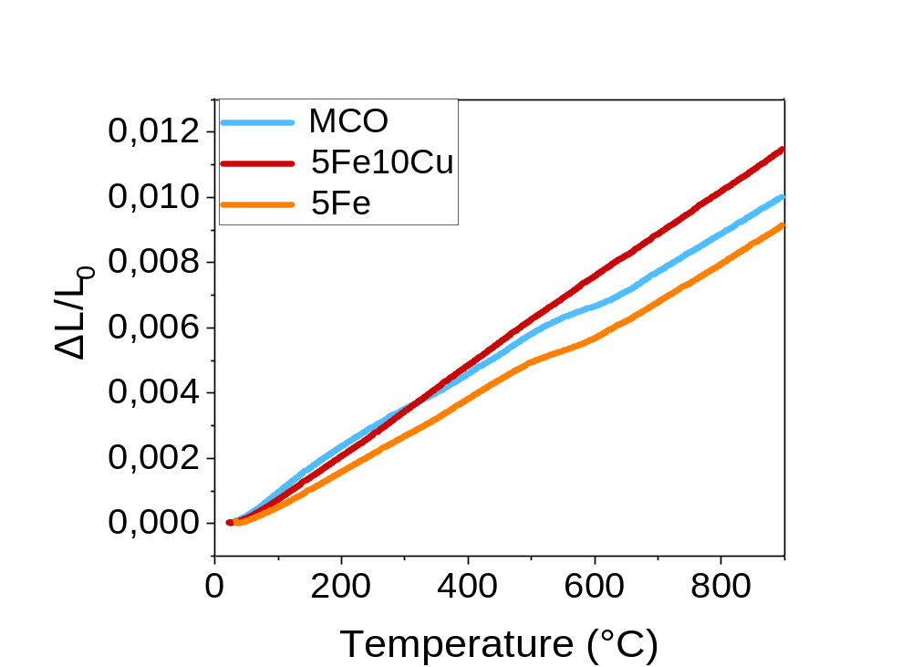
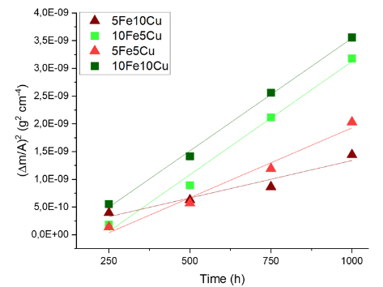
Doped spinel coatings
Characterization of Mn-Co spinel coatings with Fe-Cu addition
Assessment of dilatometric properties of Fe-Cu doped spinels
Cu addition boosts densification
No Cr diffusion during aging
Fe+Cu addition
Fe addition
Better oxidation resistance of Fe-Cu doped coatings compared to base
Mn-Co spinel
Improved spinel stability
Synergic effect of Cu and Fe
Elisa Zanchi, Politecnico di Torino

Slide 15
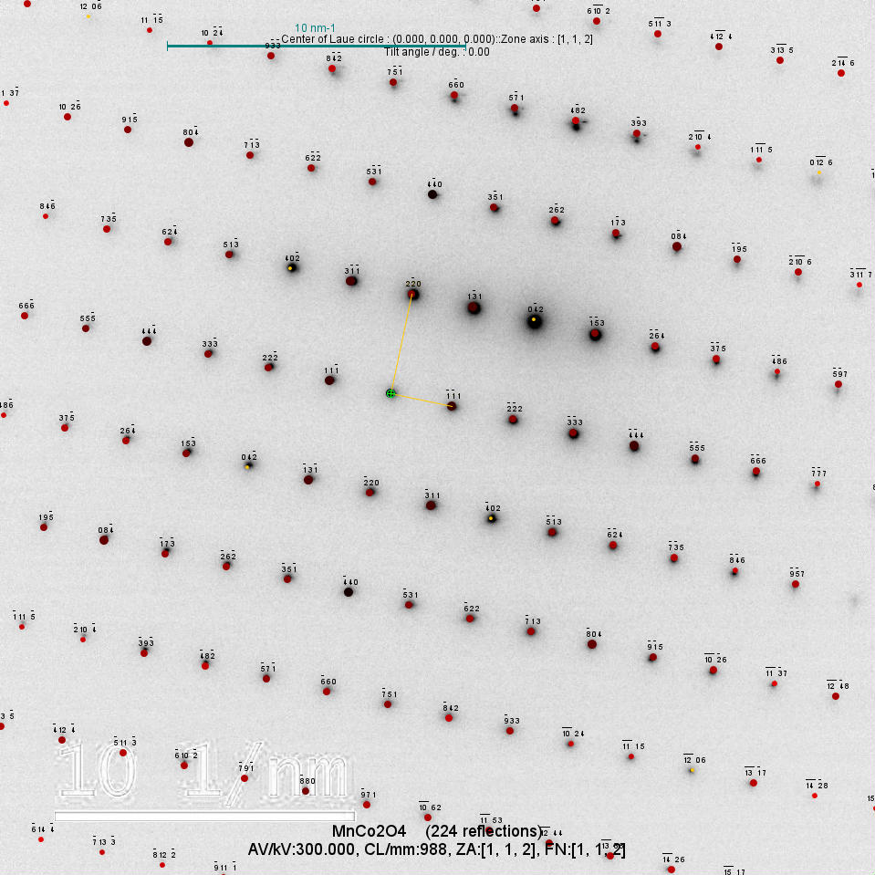
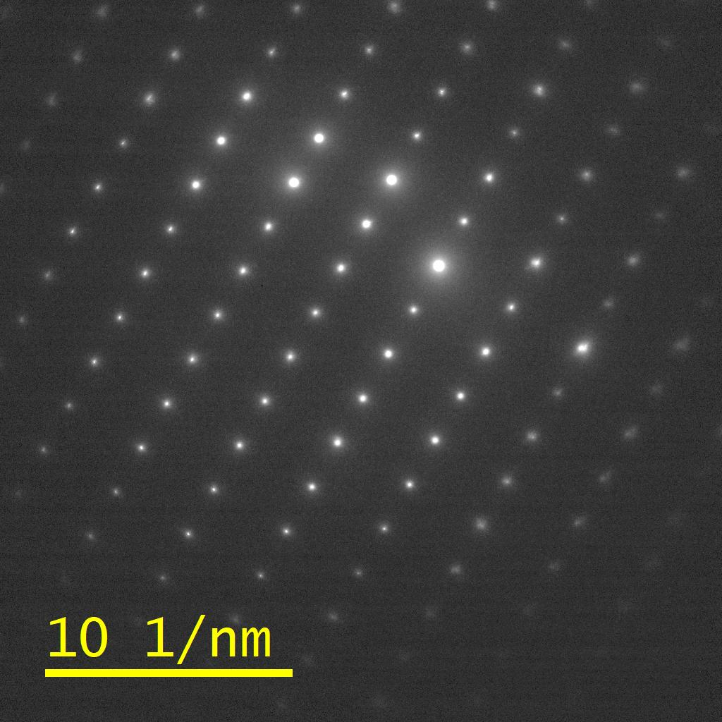
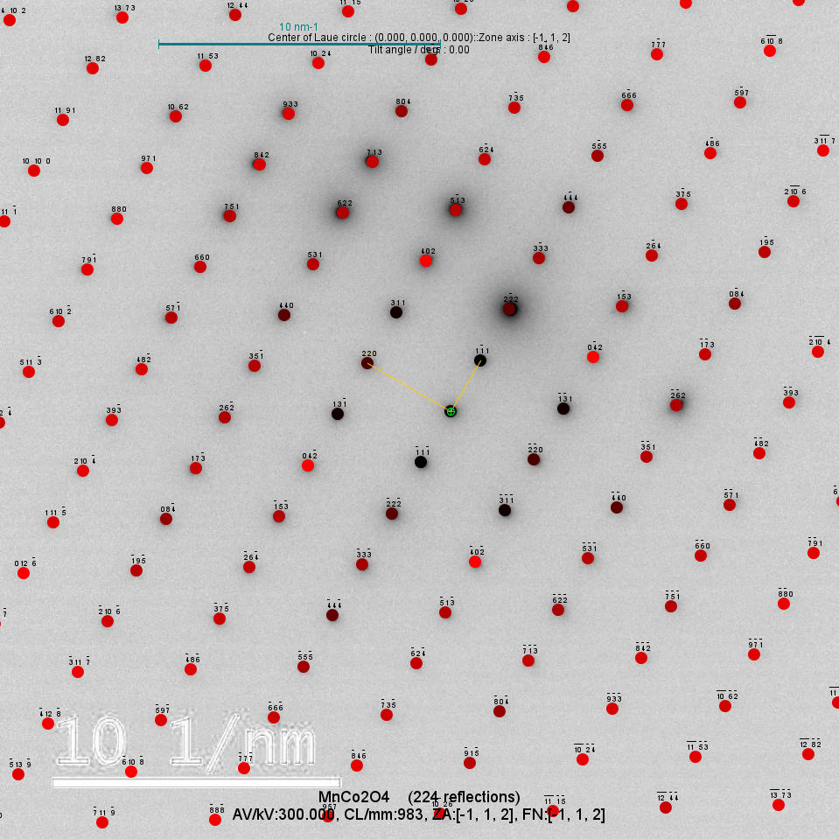
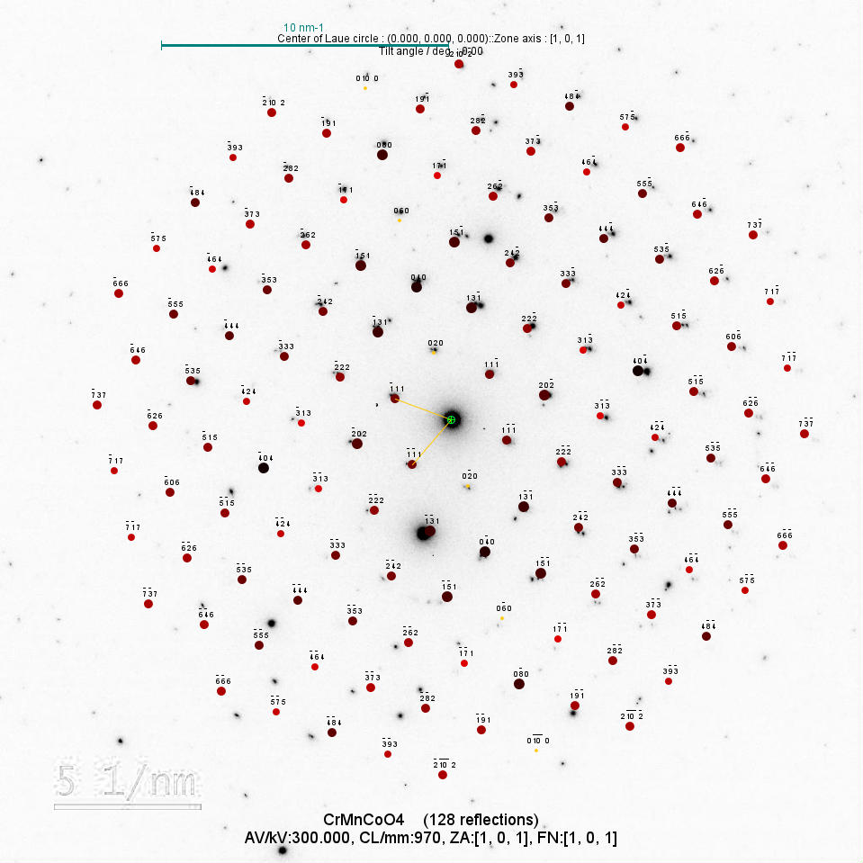
Doped spinel coatings
Advanced TEM characterization of doped coatings
10Fe10Cu sample:
Highest amount of dopants
Coating
High coating densification
Fe and Cu homogeneously distributed in the coating
Steel
Thin oxide scale
Point c2:
Solution with MnCo₂O₄
Zone axis 112
Point b1:
Solution with MnCo₂O₄
Zone axis 112
Point c3:
Solution with CrMnCoO₄
Zone axis 101
Elisa Zanchi, Politecnico di Torino

Slide 16
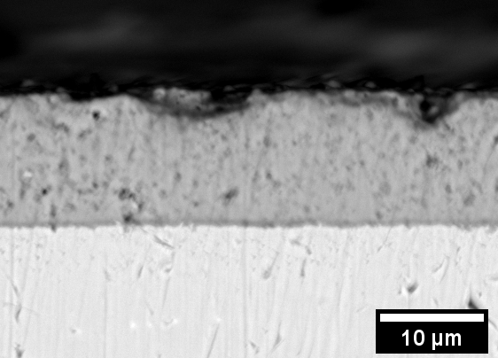
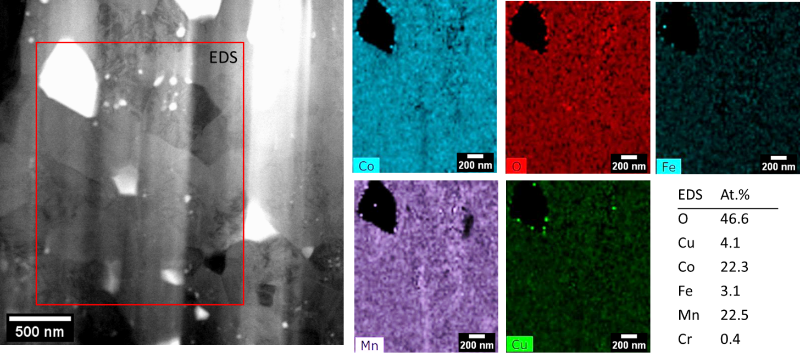
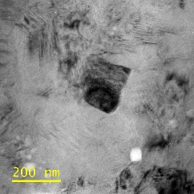
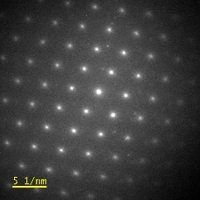
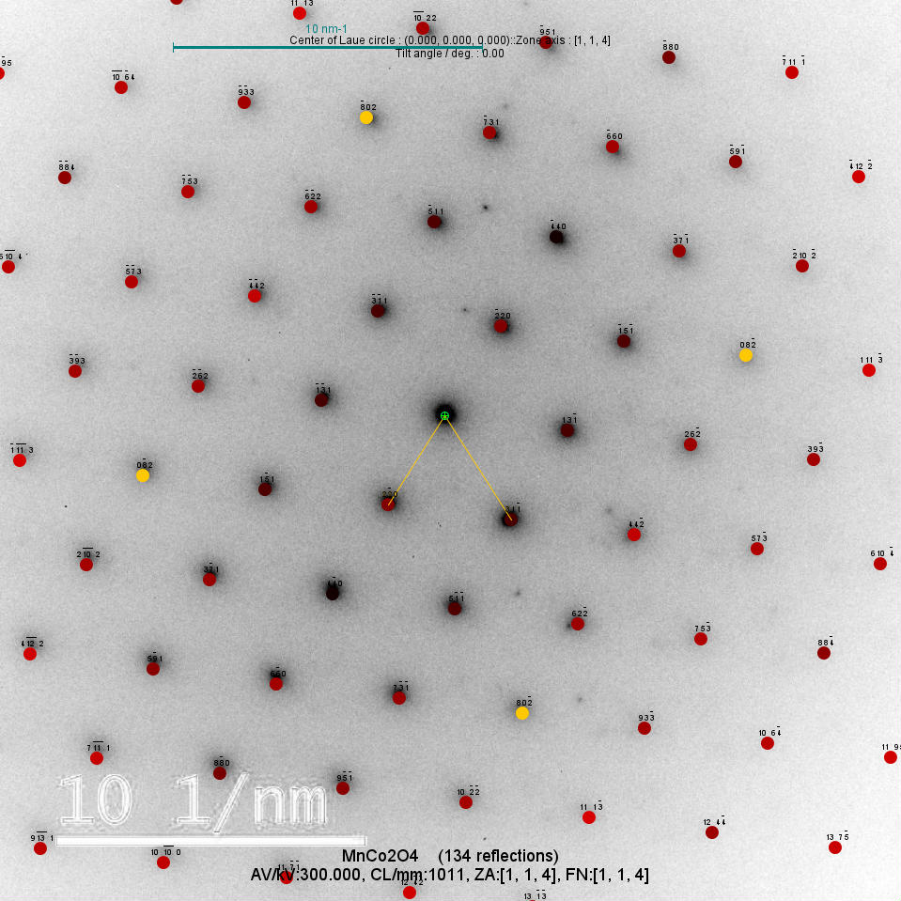
Doped spinel coatings
Advanced TEM characterization of doped coatings
5Fe5Cu sample: lowest amount of dopants
View of the lamella from the outer coating side
Coating
1
Steel
Homogeneous distribution of Fe and Cu in the Mn-Co spinel
Fe+Cu addition: synergic effect
in suppressing the double-phase spinel formation
Point 1:
Solution with MnCo₂O₄
Zone axis 114
Elisa Zanchi, Politecnico di Torino

Slide 17
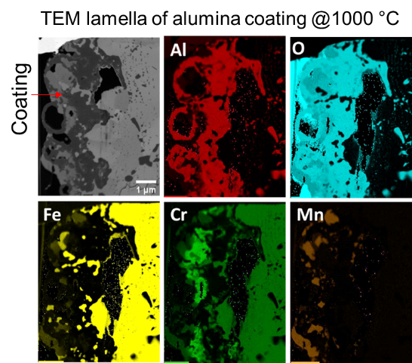
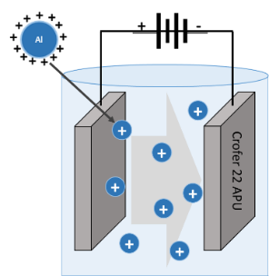
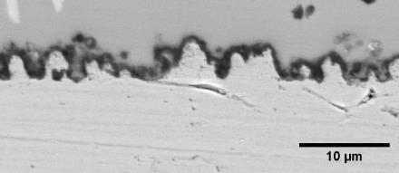



Further activities in ESTEEM3
GlaMater
“Advanced glass and ceramic materials for energy applications”
Gas tightness
  II) Design of innovative interface concepts
.. To minimize reactions between steel and the sealant
Improve thermo-mechanical properties of the joint
Successful EPD modification:
Crofer22APU
Glass ceramic sealant
HT (air)
Alumina
Crofer22APU
Alumina layer
with enhanced surface roughness
GlaMater (March 2023)
Elisa Zanchi, Politecnico di Torino

Slide 18
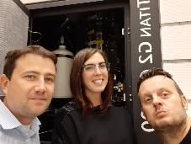
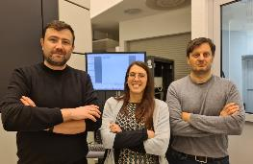
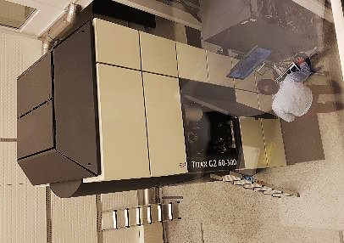
Concluding remarks
The Transnational Access
provided by ESTEEM3 Project enabled:
The consolidation of fruitful networking
Strengthening of AGH-POLITO collaboration
Publications on high-impact journals
Training on TEM characterization techniques
Professional (and personal!) experience for PhD activity
Krakow, 2019
Krakow, 2023
Results and publications
on the CeramECS projects provided:
A first in-depth characterization of Mn-Co dual spinel structure and oxide scale evolution after stack test at relevant conditions
A first comprehensive assessment of synergic effect of Fe-Cu addition into the Mn–Co spinel structure
Better understanding of coating degradation phenomena
  …to improve the performance and durability of SOC devices
  and boost hydrogen technologies
Elisa Zanchi, Politecnico di Torino

Slide 19



Acknowledgments
Electrophoretic deposition, FAU, Erlangen, Germany,
This project has received funding from the Fuel Cells and Hydrogen 2 Joint Undertaking (now Clean Hydrogen Partnership) under Grant Agreement No 874577-NewSOC. This Joint Undertaking receives support from the European Union’s Horizon 2020 Research and Innovation program, Hydrogen Europe and Hydrogen Europe Research.
Thank you for the attention
elisa.zanchi@polito.it

