Slide 1




TNA user feedback
Nano-gold on hierarchically structured gadolinium-doped ceria as an active oxidation catalyst: synergistic effect of chemical composition and structural hierarchy
THIS PROJECT HAS RECEIVED FUNDING FROM THE EUROPEAN UNION’S HORIZON 2020 RESEARCH AND INNOVATION PROGRAMME UNDER GRANT AGREEMENT NO 823717

Slide 2

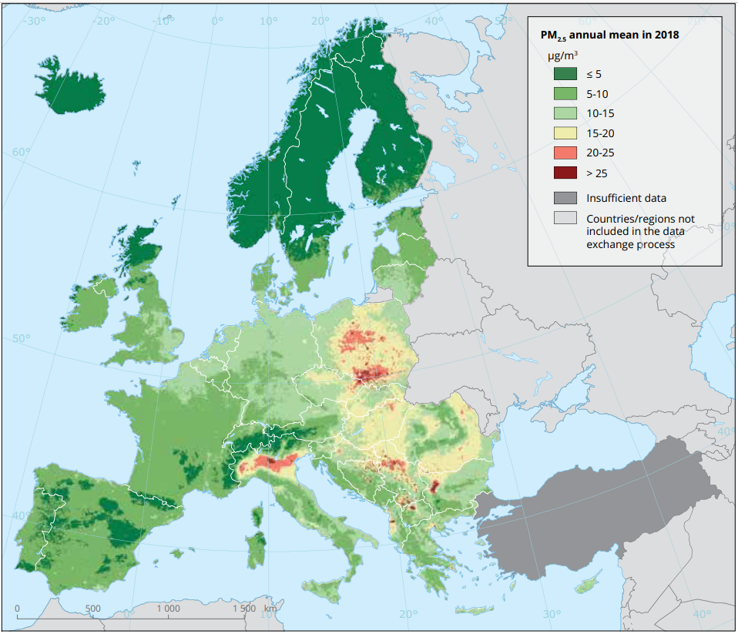
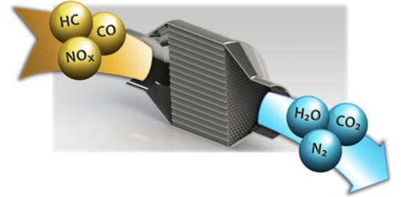

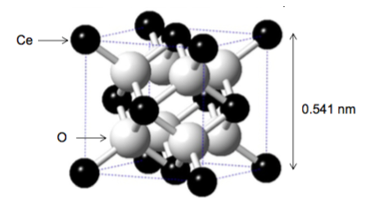

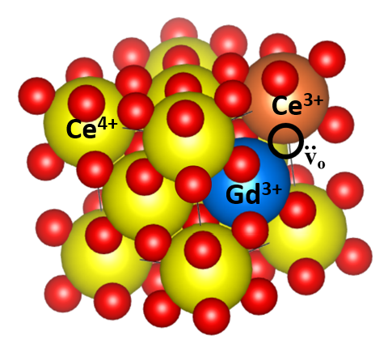
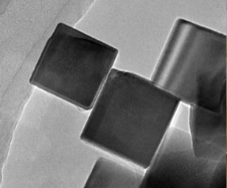
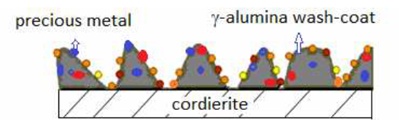
HSMCO project
Hierarchically Structured Mixed Cerium Oxides
Motivation
Automotive catalyst
CO
HC NO_{x}
PM
CeO₂
Oxygen buffer
(Ce^{IV} O₂ ↔ Ce^{IV}_{1−x}Ce^{III}_{x}O_{2−x/2})
EEA/Air quality in Europe – raport No 9/2020
Nano-size effect
Lattice parameter
Microstrain
Rh, Pd, Pt
γ-Al₂O₃
Oxygen vaccancy concentration
Electronic structure

Slide 3
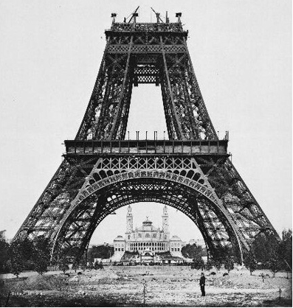
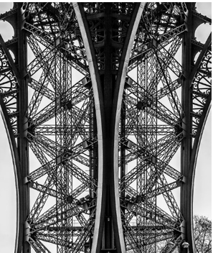

HSMCO project
Hierarchically Structured Mixed Cerium Oxides
Motivation
Structural hierarchy
3º
2º
1º
CeO₂
Oxygen buffer
(Ce^{IV} O₂ ↔ Ce^{IV}_{1−x}Ce^{III}_{x}O_{2−x/2})
Nano-size effect
Lattice parameter
Microstrain
Rh, Pd, Pt
γ-Al₂O₃
Oxygen vaccancy concentration
Electronic structure

Slide 4
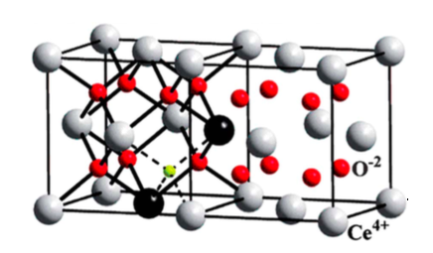

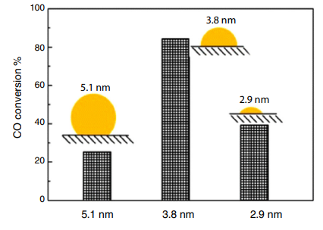
HSMCO project
Hierarchically Structured Mixed Cerium Oxides
Motivation
Structural hierarchy
3º
Doping
2º
1º
REE
(rare-earth elements)
?
Active phase deposition
Nano-size effect
Lattice parameter
Microstrain
Oxygen vaccancy concentration
Electronic structure
doi.org/10.1016/j.jmrt.2018.12.012

Slide 5
HSMCO project
Hierarchically Structured Mixed Cerium Oxides
Motivation
Determination of structure-activity relationship
HSMCO project goals
Description of the structural hierarchy of active catalytic supports and gold-decorated catalysts.
Determination of the Gd³⁺ dopant distribution throughout the system.
Determination of the distribution and location of Au NPs.
EM techniques used
HREM, EDX, EELS, HAADF-STEM, ET-HAADF
Doping
REE
(rare-earth elements)
?
Active phase deposition
doi.org/10.1016/j.jmrt.2018.12.012

Slide 6

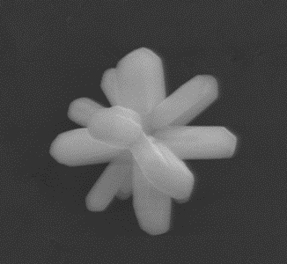
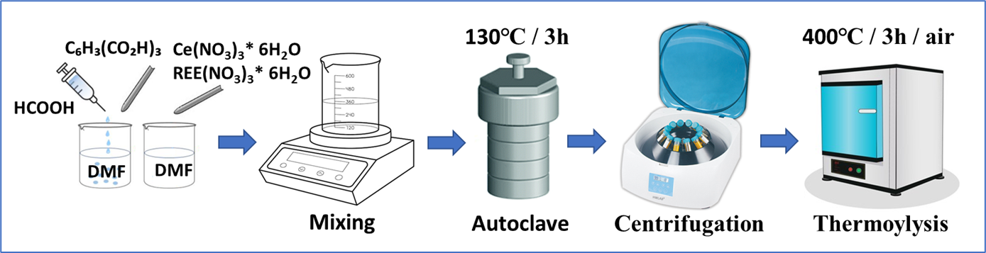
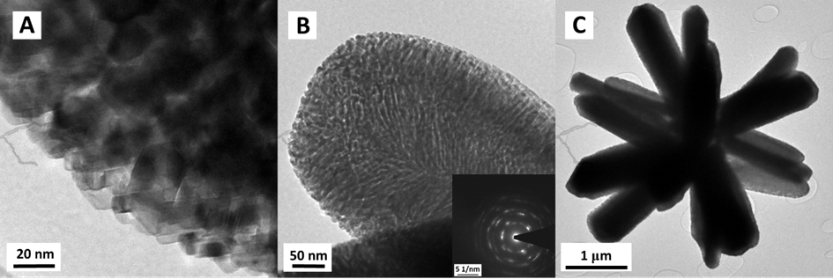
HSMCO project
Hierarchically Structured Mixed Cerium Oxides
Structural hierarchy
Synthesis
Ce(HCOO)₃
Thermolysis
2 µm
Nanoparticles
Porous rods
Star-shaped particles
1°
CeO₂
2°
3°
Rare-earth elements doping
Porosity engineering
Shape-selective synthesis

Slide 7
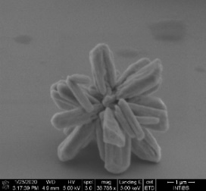
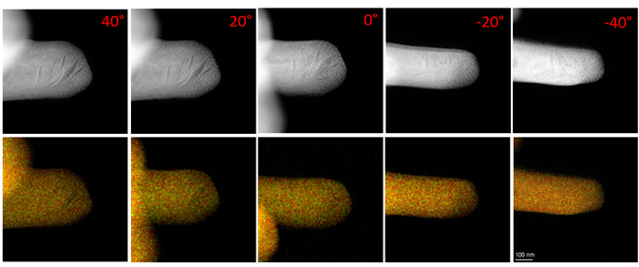
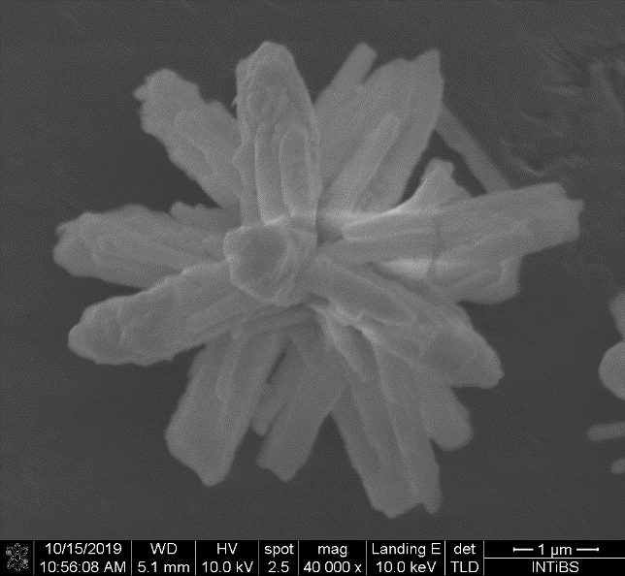
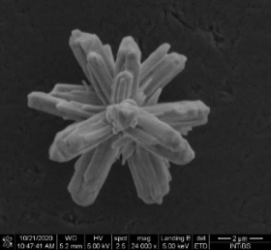
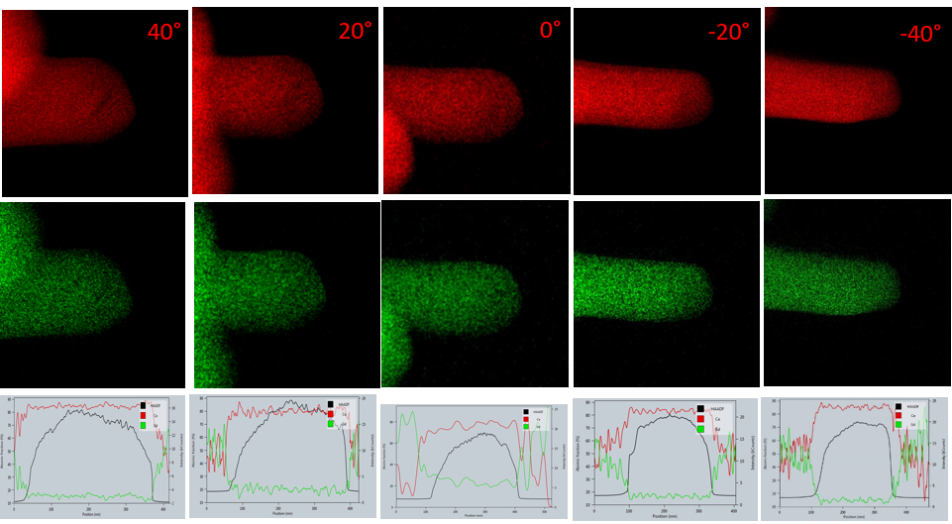
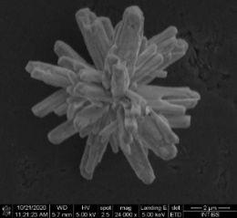
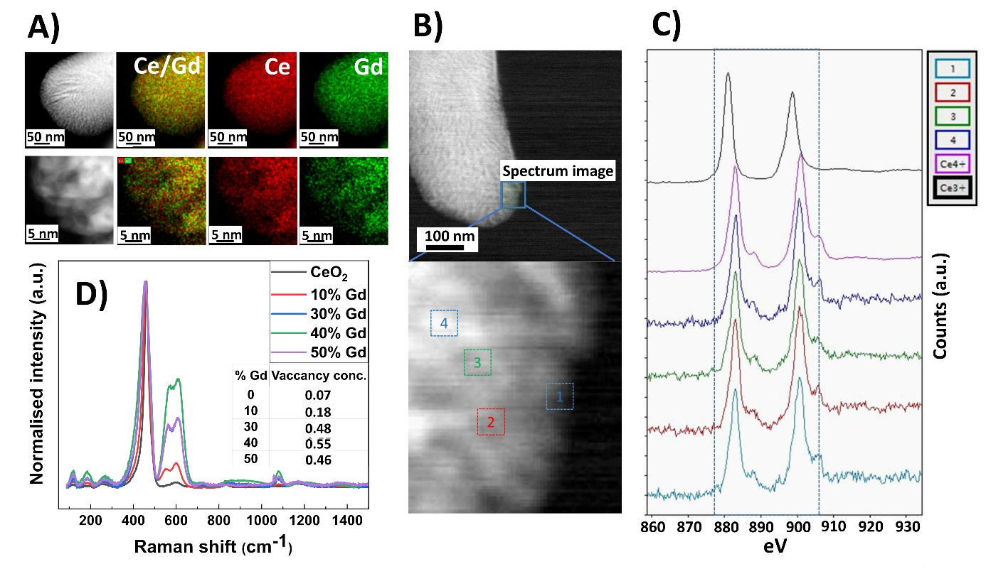
HSMCO project
Hierarchically Structured Mixed Cerium Oxides
Hierarchical structure: dopant influence
0 %
Global dopant distribution
10 %
STEM-XEDS
[D2]
30 %
dopant concentration
40 %
STEM-XEDS
50 %
70 %
Notes:
Stability of particels morphology that is depenent on opant concentration
Dopant distribution: golobal and local

Slide 8
HSMCO project
Hierarchically Structured Mixed Cerium Oxides
Hierarchical structure: dopant influence
0 %
Microstructure
10 %
DF, EELS
[D2]
30 %
dopant concentration
40 %
STEM-XEDS
50 %
70 %
Notes:
Stability of particels morphology that is depenent on opant concentration
Dopant distribution: golobal and local

Slide 9
HSMCO project
Hierarchically Structured Mixed Cerium Oxides
Hierarchical structure: dopant influence
0 %
Microstructure
10 %
Raman
[D2]
30 %
dopant concentration
40 %
STEM-XEDS
50 %
70 %
Notes:
Stability of particels morphology that is depenent on opant concentration
Dopant distribution: golobal and local

Slide 10
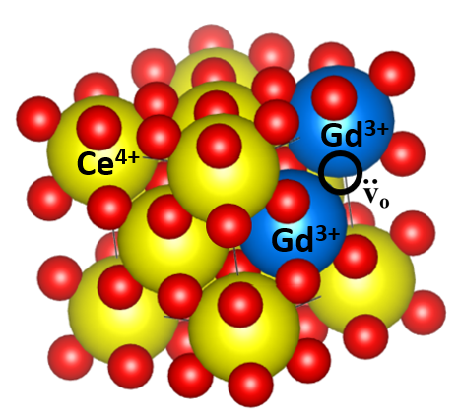
HSMCO project
Hierarchically Structured Mixed Cerium Oxides
Hierarchical structure: dopant influence
0 %
Microstructure
10 %
Raman
[D2]
30 %
dopant concentration
40 %
dopant clustering
50 %
70 %
Notes:
Stability of particels morphology that is depenent on opant concentration
Dopant distribution: golobal and local

Slide 11
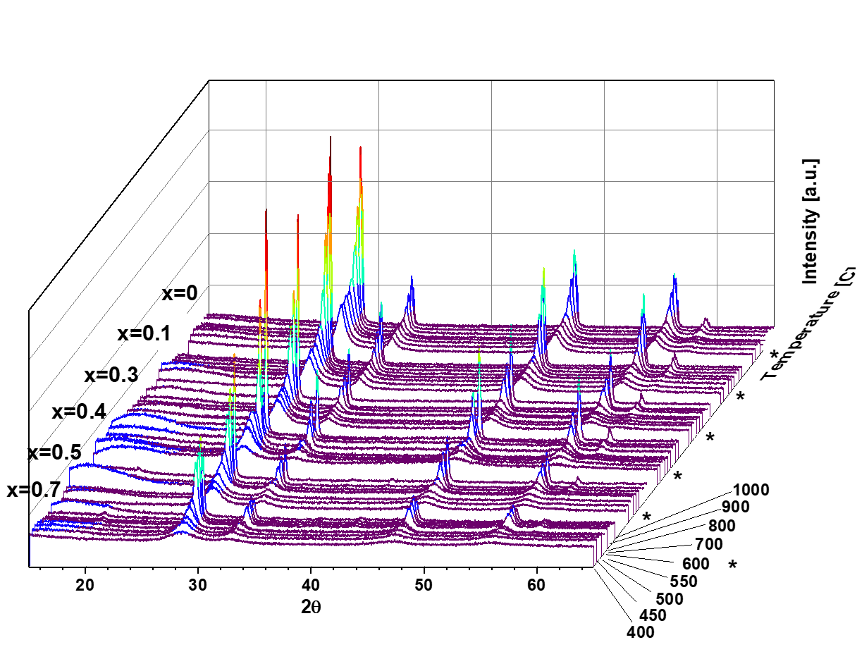
HSMCO project
Hierarchically Structured Mixed Cerium Oxides
Hierarchical structure: dopant influence
0 %
Crystal structure
PXRD Ce_{1-x}Gd_{x}O_{2-x/2}
10 %
[D2]
Dopant concentration
30 %
dopant concentration
40 %
dopant clustering
Temperature [℃]
50 %
70 %
Notes:
Stability of particels morphology that is depenent on opant concentration
Dopant distribution: golobal and local

Slide 12
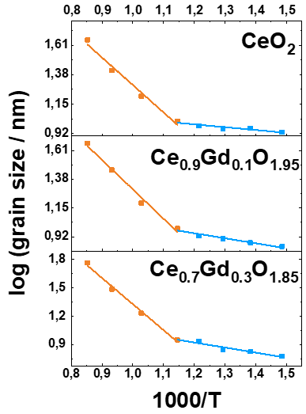
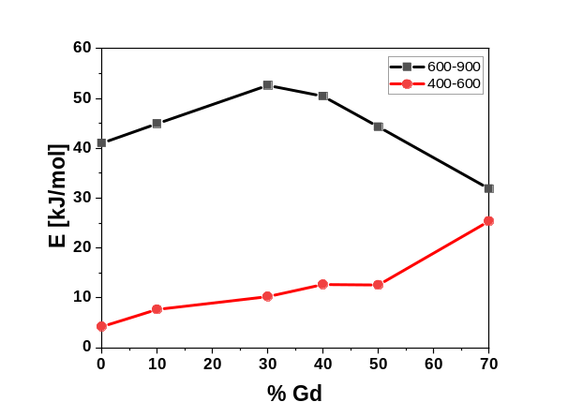


HSMCO project
Hierarchically Structured Mixed Cerium Oxides
Hierarchical structure: dopant influence
Crystal structure
PXRD Ce_{1-x}Gd_{x}O_{2-x/2}
Dopant concentration
Activation energy of NPs growth
Temperature [℃]
$$lnD=Ae^{−\frac{E_{a}}{RT}}$$
$$D ≈ \frac{λ}{β_{2θ}cosθ}$$

Slide 13
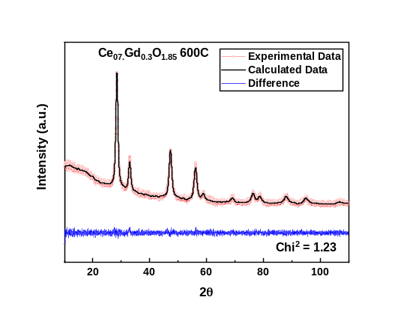
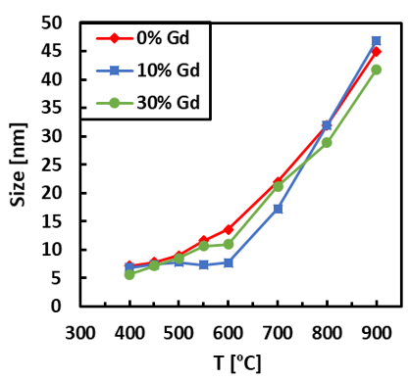
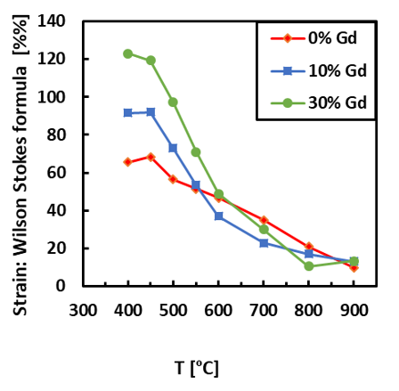
HSMCO project
Hierarchically Structured Mixed Cerium Oxides
Hierarchical structure: dopant influence
Crystal structure
Rietveld refinement
PXRD Ce_{1-x}Gd_{x}O_{2-x/2}
Dopant concentration
Temperature [℃]
NPs size
NPs strain

Slide 14
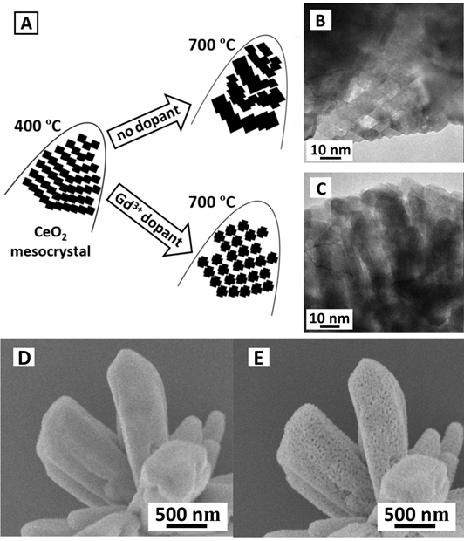
HSMCO project
Hierarchically Structured Mixed Cerium Oxides
Hierarchical structure: dopant influence
Evolution of the support architecture
Rietveld refinement
NPs size
NPs strain

Slide 15
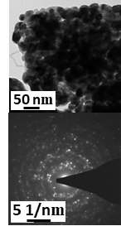
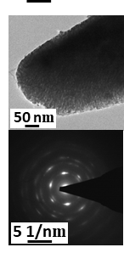
HSMCO project
Hierarchically Structured Mixed Cerium Oxides
Hierarchical structure: dopant influence
Evolution of the support architecture
Stability of the architecture in soot combustion

Slide 16
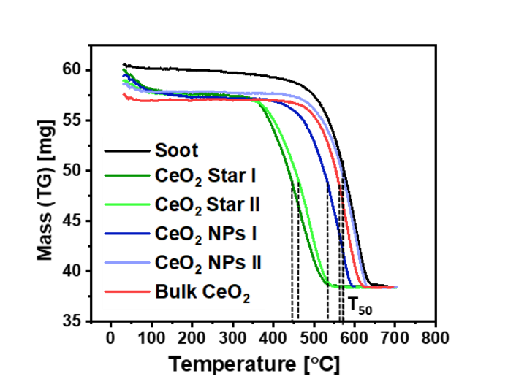
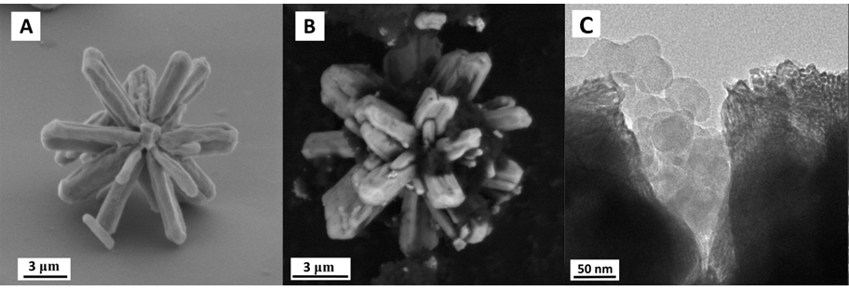
HSMCO project
Hierarchically Structured Mixed Cerium Oxides
Catalytic activity
Soot combustion
Stability of the architecture in soot combustion

Slide 17
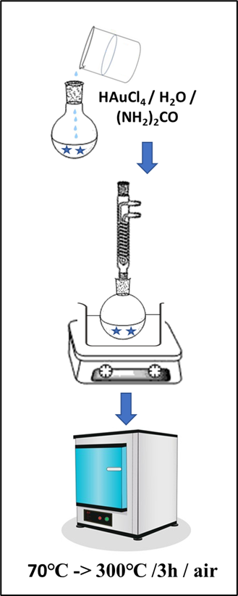
HSMCO project
Hierarchically Structured Mixed Cerium Oxides
Active phase deposition

Slide 18
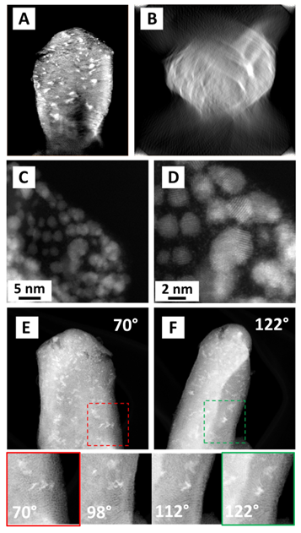
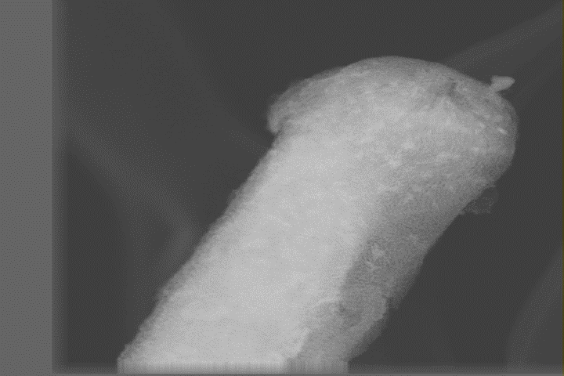
HSMCO project
Hierarchically Structured Mixed Cerium Oxides
Active phase deposition
Electron Tomography
Filmik tomografia
Au5/ CeO₂ HSNPs

Slide 19
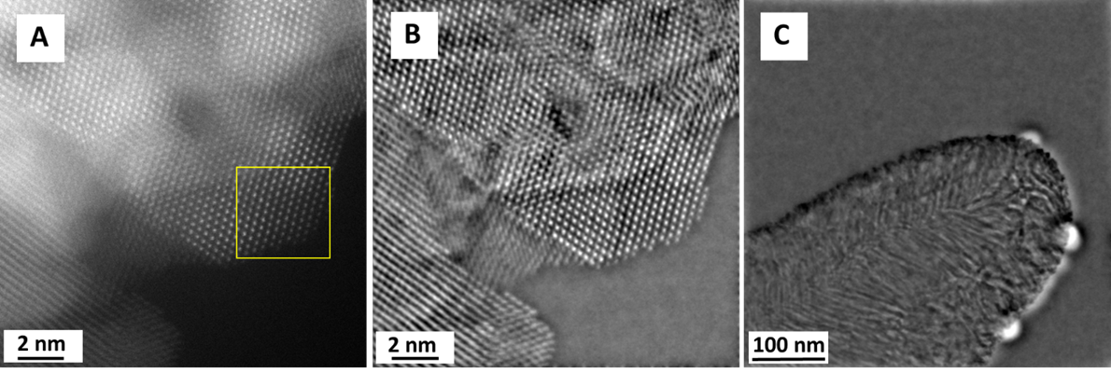
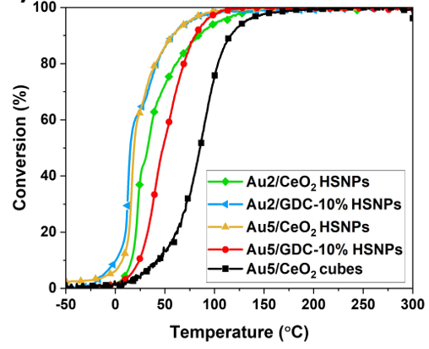
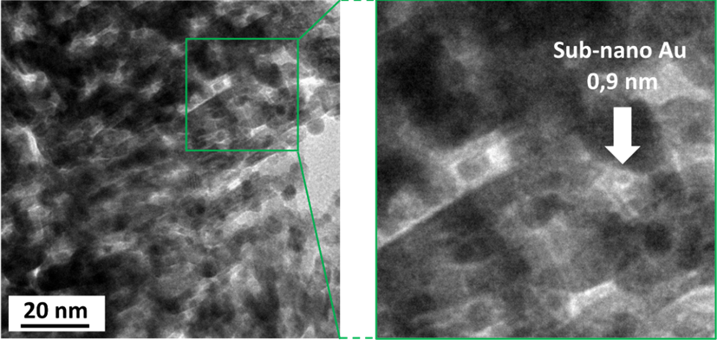
HSMCO project
Hierarchically Structured Mixed Cerium Oxides
Catalytic activity
CO oxidation

Slide 20
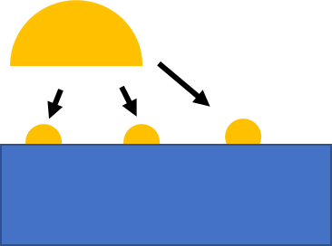


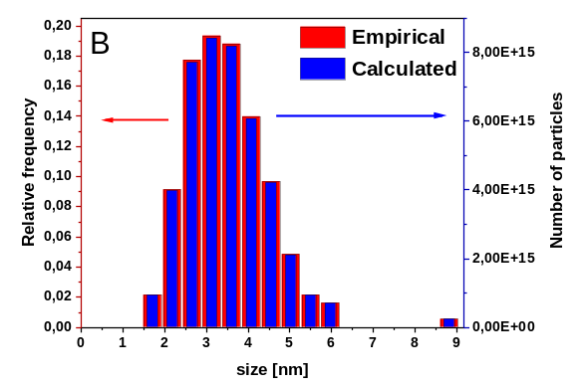

HSMCO project
Hierarchically Structured Mixed Cerium Oxides
Synergistic effect of chemical composition and structural hierarchy
TOF
Atom normalization
CO chemisorption
Proposed approach
TEM data + simulation
$$TOF= \frac{reaction rate}{number of active sites }$$

Slide 21
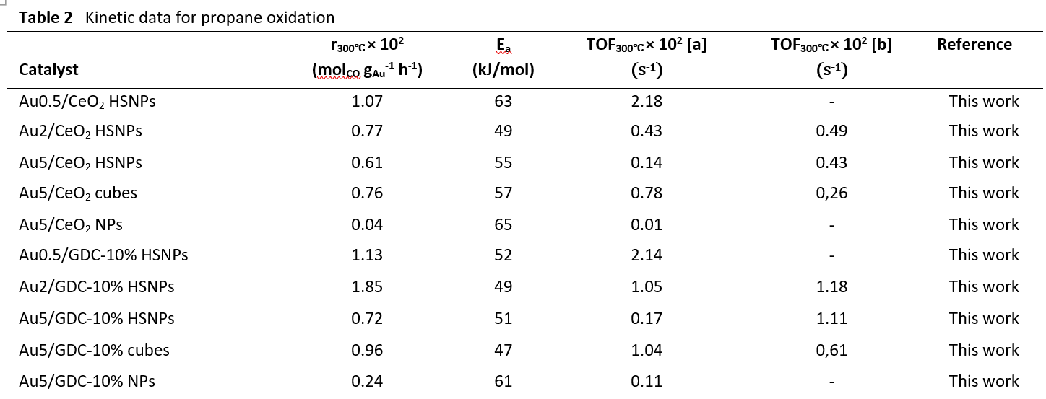
HSMCO project
Hierarchically Structured Mixed Cerium Oxides
Synergistic effect of chemical composition and structural hierarchy
TOF
Atom normalization
CO chemisorption
Proposed approach

Slide 22
HSMCO project
Hierarchically Structured Mixed Cerium Oxides
Conclusions
Hydrothermal synthesis + thermolysis + deposition-precipitation -> catalyst with structural hierarchy and superior activity
Gd³⁺ increases activity and stability of the architecture of catalyst
Gd³⁺ influences the temperature-dependent evolution of the architecture
Synergistic effect of structural hierarchy and doping in propane oxidation

Slide 23
HSMCO project
Hierarchically Structured Mixed Cerium Oxides
Thank you for your attention!
Literature
Woźniak, P., Małecka, M.A., Chinchilla, L., Trasobares, S., 3D hierarchically structured Ce_{1-x}Gd_{x}O_{2-x/2} mixed oxide particles: the role of microstructure, porosity and multi-level architecture stability in soot and propane oxidation, Mater. Res. Bull., 2022, 151, 111816.
Woźniak, P., Małecka, M.A., Kraszkiewicz, P., Miśta, W., Bezkrovnyi, O., Chinchilla, L., Trasobares, S., Confinement of nano-gold in 3D hierarchically structured gadolinium- doped ceria mesocrystal: synergistic effect of chemical composition and structural hierarchy in CO and propane oxidation. Catal. Sci. Technol., 2022, 12, 7082-7113.
Woźniak P., Miśta W., Małecka M.A., Function of various levels of hierarchical organization of porous Ce_{0.9}REE_{0.1}O_{1.95} mixed oxides in catalytic activity, CrystEngComm, 2020, 22, 5914-5930.

